Slide 1
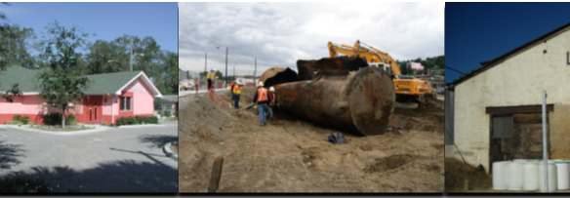
Disaster-B2H: Leveraging Brownfields to Healthfields for Disaster Recovery
July 11, 2018

Slide 2
Meet the Disaster- B2H Presenters
Matthew Tejada, Director, Office of Environmental Justice (OEJ) , US EPA
Dan French, CEO - Brownfield Listings, LLC
Suzi Ruhl, Senior Counsel, OEJ, US EPA; Co-chair, Rural Communities Committee, EJIWG
Amy Dinn, Managing Attorney, Environmental Justice Team, Lone Star Legal Aid

Slide 3
Agenda
Setting the Stage
1
Understanding B2H
2
Mitigating Flooding and Revitalizing Brownfields in Houston
3
Engaging Communities for Disaster-B2H
4
Case Example
Opening Remarks
Building Blocks
Welcome and Introductions
National Momentum
Next Steps

Slide 4
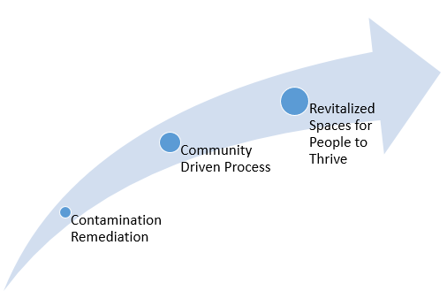
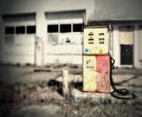
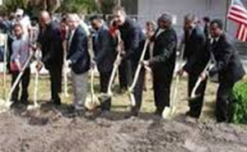
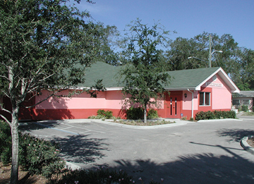
B2H:
Model Approach
B
2
H
Transformation of contaminated properties to strengthen community health, equity, sustainability and resiliency for impacted vulnerable and underserved populations living in areas with pollution, disease, poverty and crime

Slide 5
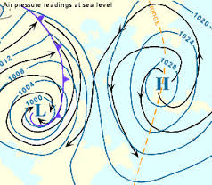
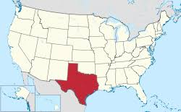

B2H: Local to National
Community Resilience
Grassroots created and driven
Multi-stakeholder collaborative effort and inclusive approach
Leverages private and public investment in impacted communities
Flips community challenges into community opportunities

Slide 6
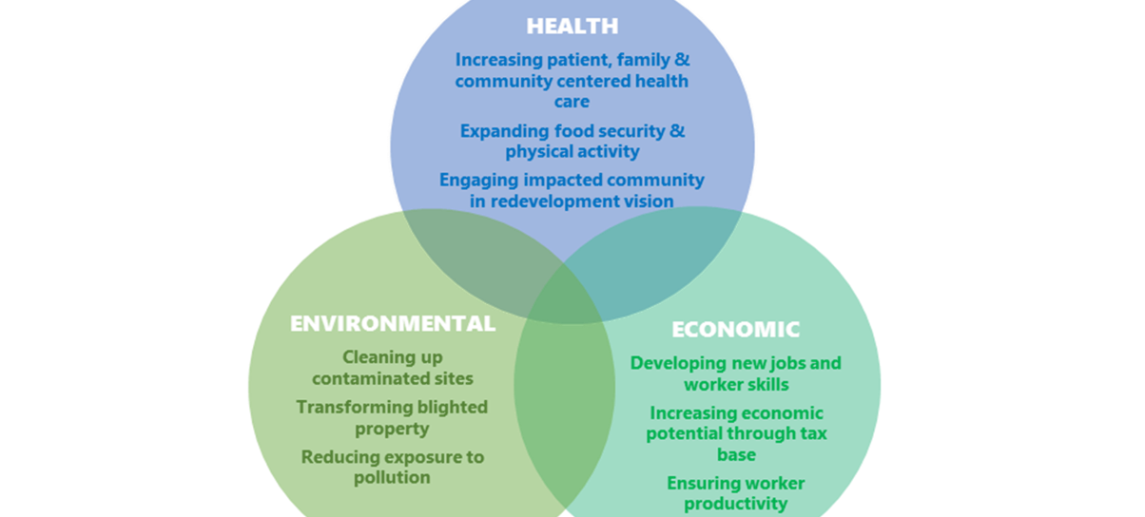
B2H:
Triple Bottom Line
Benefits
Health
Environmental
Economic
Notes:
This approach helps local organizations access state and federal resources to transform brownfields and blighted properties into community spaces that improve the environment, public health and economic potential of vulnerable communities. Health benefits include reducing exposure to pollution; increasing patient, family and community centered health care; increasing food security, and creating public space for physical activity. This approach also catalyzes private investment by increasing economic potential through the tax base, developing new jobs and worker skills, and supporting economic resiliency.

Slide 7
Healthfield Redevelopment
Common Brownfield Sites
Common Contamination
Hazardous Substances
Petroleum Contamination
Asbestos Containing Materials
Substances used in illegal drug manufacturing
(e.g. meth labs)
Mine-Scarred/Abandoned Mine Lands
Other environmental contaminants (e.g. animal/farm waste)
Abandoned gas stations
Buried tanks
Former mines and tailings
Illegal dump sites
Meth labs or former grow sites
Landfills
Historic industrial operations
Maintenance yards
Former feed lots
Medical Center/Health Clinic
Housing
Open Space/Recreational
Agriculture
Farmer’s Market
Grocery Store
School
Community Center
Lead Based Paint

Slide 8
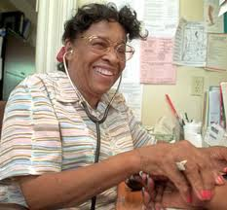

B2H Success Model: Environmental Justice (Clearwater, FL)
Focus:
Merger between environmental justice and brownfields redevelopment
Free medical care
Medical workforce development and training
Assets:
Property provided for low/no cost by city (i.e. $1 per year)
Florida legislature support through tobacco funds
EPA petroleum tank removal funding
Philanthropy and Private Support
I want my friends to stop dying at the bus stop
Willa Carson Community Health and Wellness Center

Slide 9



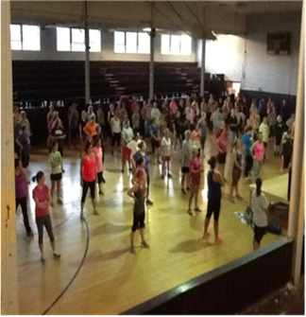

B2H Success Model: Rural Communities (Grundy County, TN)
Community Driven Outcomes:
Community space for health care, physical activity, job training
Design:
Partnership of community & faith based organizations, health care, academic, government, philanthropy, industry
Special Assets:
Rural development, diabetes, energy, housing, entertainment industry

Slide 10


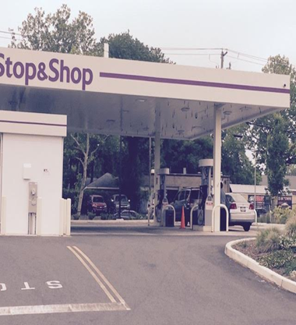

B2H Success Model: Climate Resiliency (New Haven, CT)
Community-Driven Outcomes
Behavioral wellness
Community Ambassador Job Creation
Evidenced-based Adaptive Approach
Replicable and Scalable Model
Design:
Partnership of community organizations, academic, private sector, clinical care, government
Special Assets:
$6.2 million Hurricane Sandy Social Service Block Grant

Slide 11

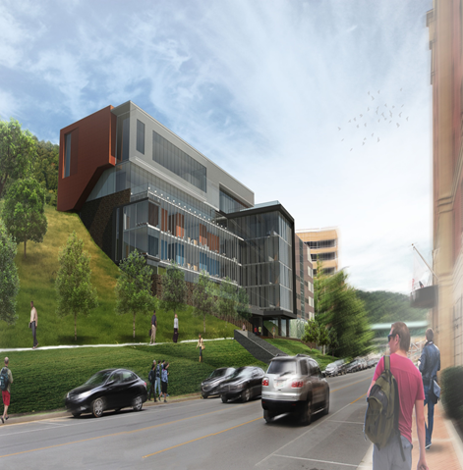
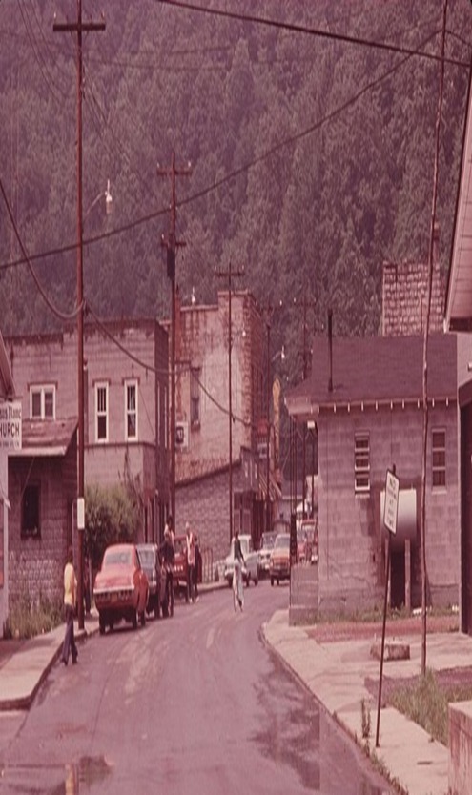
B2H Success Model: Vision Health (Pikeville, KY)
Phase 1
Big Sandy Health Care meets Jerry’s Market
Big Sandy Health Care initiates collaboration with KY Dept. for Environmental Protection
Phase 2
Big Sandy Health Care envisions adjacent property for clinical services
Brownfield program awards an environmental site assessment to Big Sandy Health Care
University of Pikeville, Kentucky College of Optometry collaboration for Eula Hall FQHC

Slide 12
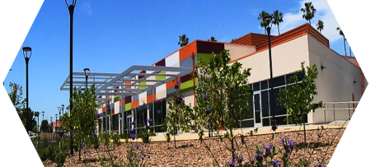
B2H Success: Agriculture and Health (Los Angeles, CA)
Community Conservation Center
Technology Lab
Financial Empowerment Center
Fitness Workshops
Community Garden & Healthy Living Café
Job Training & Leadership Development for Youth, Adults & Re-entry Clients
Public Safety & Enforcement Drop-in Site
Senior & Afterschool Programs
Small Business Center & Incubator
Health &Vision Clinic
3D Learning Lab
Photo from Neighborhood Housing Services Center for Sustainable Communities

Slide 13
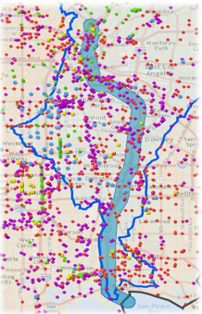
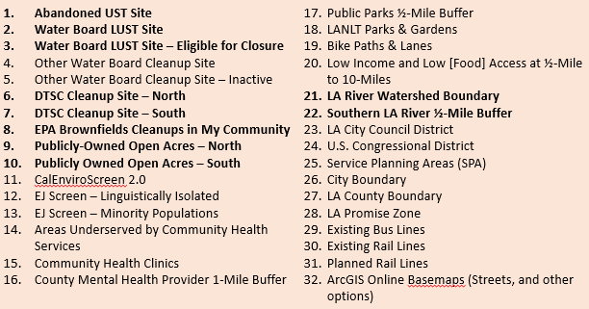
B2H Success Model:
Los Angeles River & I-710

Slide 14
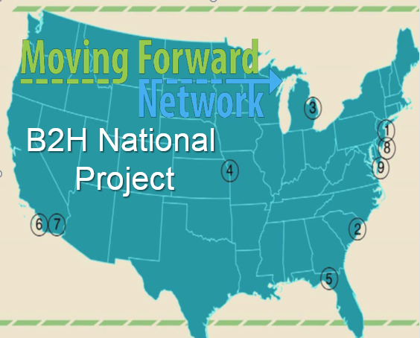
Success Model: Port Communities B2H
1. Clean Water Action, Southward of Newark, NJ
2. Lowcountry Alliance for Model Communities, Charleston, SC
4. Diesel Health Project, Kansas City, KS
5. Citizens for a Sustainable Future, Tallahassee
6. East Yard Communities for Environmental Justice, East and Southeast Los Angeles, Long Beach, CA
7. Comite Civico del Valle, Brawley, CA
8. New Jersey Environmental Justice Alliance, Newark, NJ
9. lronbound Community Corporation, East of Newark, NJ

Slide 15
BUILD Act Highlights for Communities
Funding
  $250 million annually authorized – $200M for EPA brownfields program; $50M annually for State brownfields programs
  Bigger cleanup grants – Law allows EPA to increase Brownfields Cleanup Grants from $200,000 to $500,000 (or even $650,000 based on anticipated level of contamination, size of site, and ownership status)
  Multipurpose grants – New Multipurpose Grant program created to allow inventory, assessment, planning and cleanup activities under one grant, which may be up to $1 million
  Admin costs: Up to 5% of EPA grants may be used for recipients administrative costs

Slide 16
BUILD Act Highlights for Communities
Brownfield Grants for Non-Profits
Definition of “eligible entity” for EPA brownfield grants changed to allow 501(c)(3) non-profit organizations to receive brownfield assessment, cleanup, RLF or multipurpose grants
Petroleum Brownfields
Changes the definition of a petroleum site classified as a “brownfield” by dropping the requirement that EPA or the State determine that the petroleum site be “of relatively low risk, as compared with other petroleum-only sites in the State”, and slightly clarifies the requirement that the petroleum-only site have no viable PRP and will be addressed by a non-PRP

Slide 17
BUILD Act Highlights for Communities
New Support for Sustainable Communities Importance
Allows U.S. EPA to provide up to $1.5 million annually for grants, up to $20,000, to brownfields support to small, rural and disadvantaged communities
Allows States & Tribes to use their EPA funding to assist small, rural and disadvantaged communities
  “Small” = Less than 15,000 population; “Disadvantaged” = Annual median household income

Slide 18
BUILD Act Highlights for Communities
Liability Protections
Local government acquisition – New clarity on local government sovereign acquisition of sites by seizure, law enforcement tax foreclosure, abandonment, bankruptcy, or other local functions – takes out confusing word “involuntary”
Publicly-owned sites acquired before 2002 – Localities can receive EPA grants for sites acquired before 2002, even if BFPP status for brownfield site ownership is not shown, as long as locality did not “cause or contribute” to a pollution release
Liability protections for leaseholders
Protection for Alaskan Natives – Removes liability for Alaskan villages or corporations who received a contaminated site from U.S. government

Slide 19
BUILD Act Highlights for Communities
Implementation by U.S. EPA
Mandatory statutory provisions:
Implementation of provisions on government acquisition
Alaska Native acquisition
Petroleum Brownfields definition
Lease prospective purchaser provisions
Expanded eligibility for non-profit organizations
Treatment of certain publicly-owned brownfield sites
New grant criteria for waterfront & energy brownfields
Administrative costs for brownfield grantees
Establishment of Multipurpose Brownfields grant program

Slide 20
BUILD Act Highlights for Communities
EPA Discretion
How large Cleanup grants will be up to limits of $500,000 or $650,000 with waiver
How large Multipurpose grants will be up to $1 million
How to establish & fund the technical assistance program for small/rural/disadvantaged communities- States have discretion on whether to use their EPA funding to support assistance for such communities
Gathering Public Input on Program
Timing for FY2019 implementation & grants

Slide 21
Disaster-B2H: Getting Started
Build from an established architecture
Guide through principles of collaboration
Inform decision-making with data collection and data analysis
Apply an adaptive approach
Centric to impacted people

Slide 22
Disaster-B2H:
Capturing
Assets
Community Driven and Directed Vision
Tangible, Measurable Outcomes
Community of Practice
Statutory Basis
Resourced Allies
Economy of Scale / Replicable

Slide 23
Disaster B2H: Ready to Launch
Engagement
Brownfields
Healthfields
Community Engagement, Vision &
Direction
Construction
& Operation
B2H
Success
Contaminated
Site Remediation

Slide 24

More Information and Resources
Rural Environmental Justice Resource Collection (USDA’s website)
Brownfields to Healthfields (EPA’s Environmental Justice FY17 Progress Report, p. 28)
Brownfields to Healthfields: Championing the Triple Bottom Line for Community Infrastructure (EJ IWG Access & Awareness Webinar, December 2016)
Brownfields to Healthfields Presentation on Florida Healthfields Successes (March 2015)
Neighborhood Housing Services Community Sustainability Center https://youtu.be/W_HksfcqY6U

Slide 25
Disaster-B2H in Houston
QUESTIONS?
US EPA Office of Environmental Justice

Slide 26

https://brownfieldlistings.com/ info@brownfieldlistings.com
DAN FRENCH, CEO, Brownfields Listings, LLC

Slide 27
Bringing B2H to Disaster-Prone Houston
AMY DINN, Environmental Justice Attorney, Lone Star Legal Aid

Slide 28
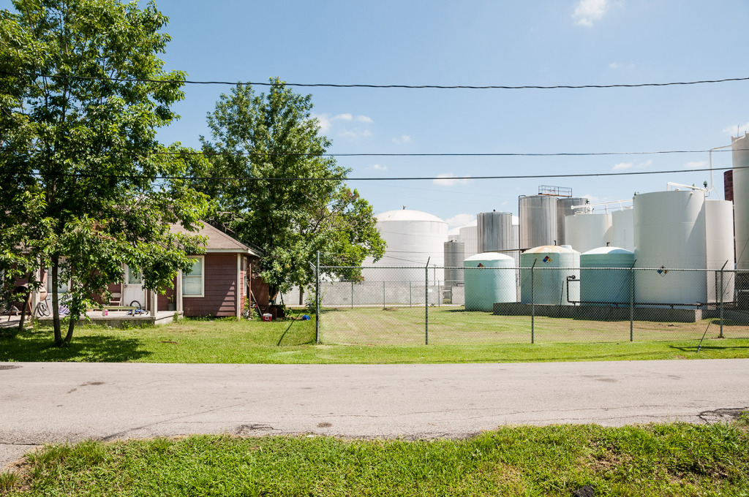
Houston Challenges
No Zoning
LSLA File Photo

Slide 29
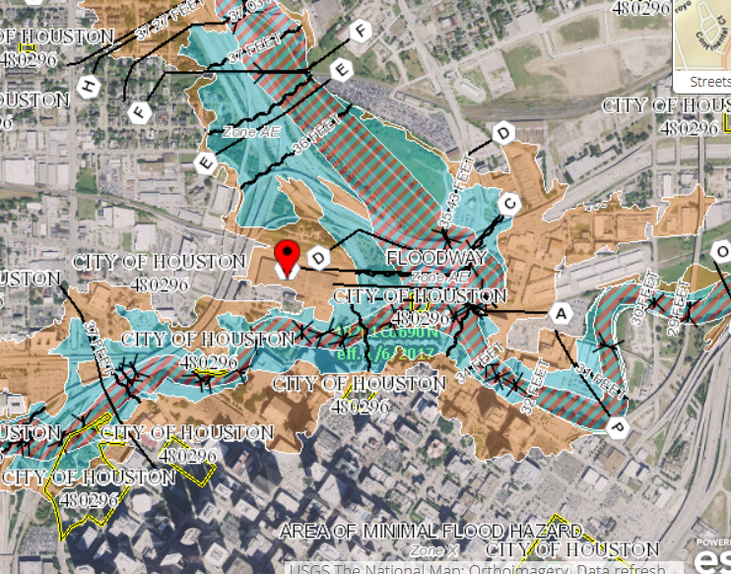
Houston Challenges
Developed
Flood Plain
https://msc.fema.gov/

Slide 30
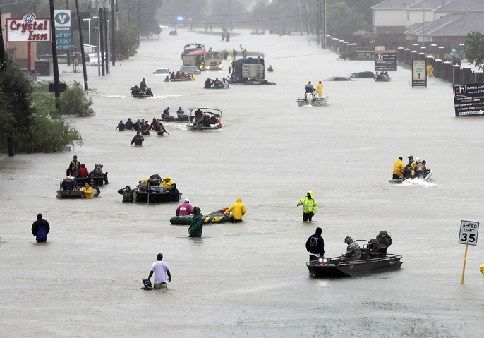
Houston Challenges
Flooding
2015
2016
Harvey
David J. Phillip / AP

Slide 31
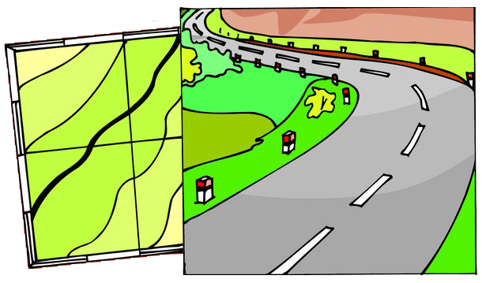
ROADMAP TO RESILIENCE

Slide 32
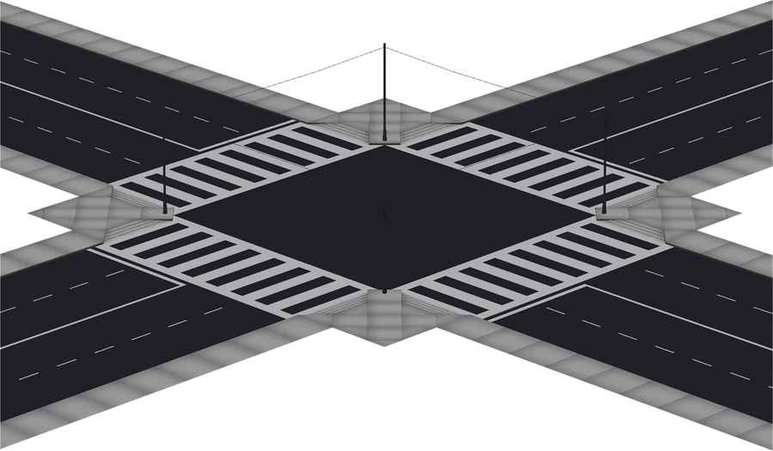
Identify Disaster-Prone Areas
Flood plain
Repetitive flooding
Brownfields
Voluntary Cleanup Program
RCRA sites
Superfund

Slide 33
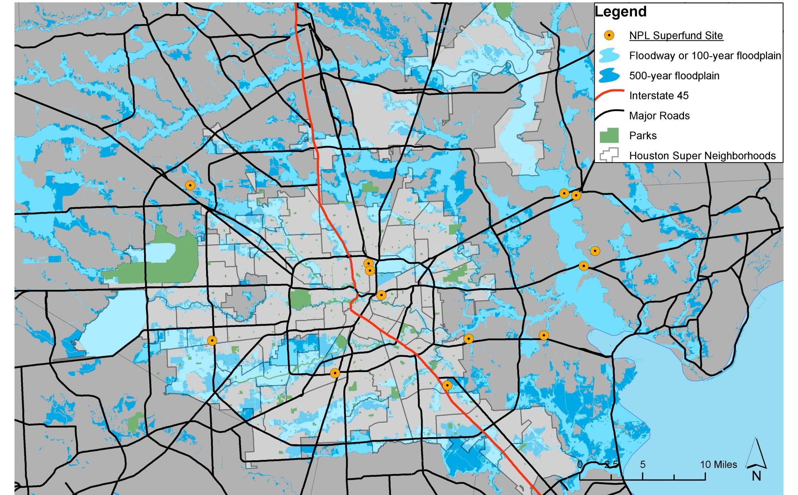
Flooded Superfund Sites

Slide 34
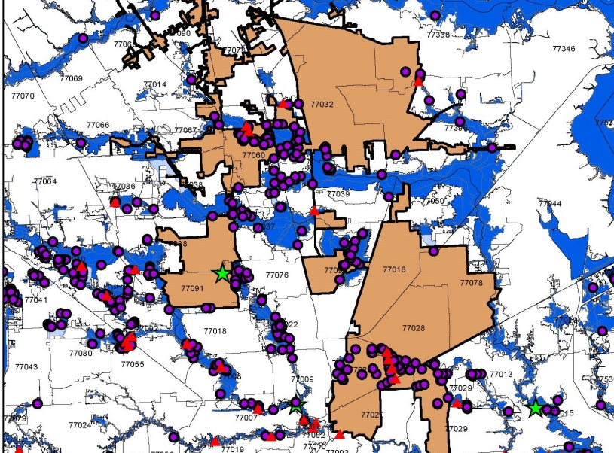
Flooded Brownfields

Slide 35
2. Prioritize Neighborhoods
Flooding is severe or repetitive
Unmet needs or Low to Moderate Income (LMI) population (FEMA claims data)
Community interest in redevelopment
Desire for health-based solutions

Slide 36
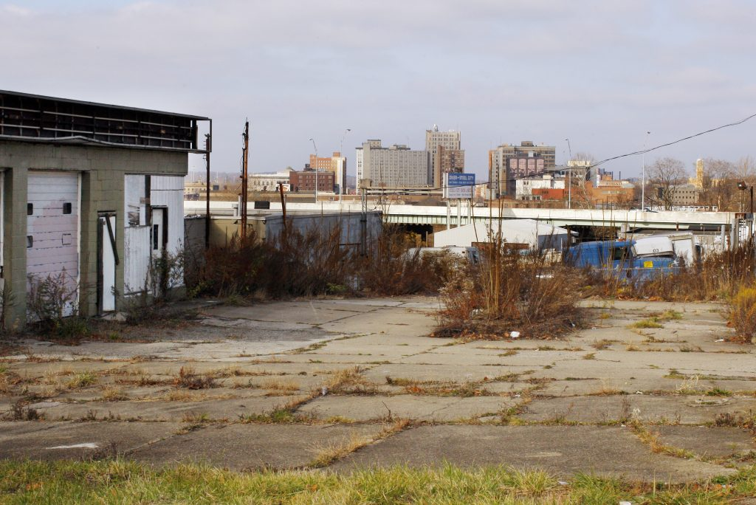
3. Identify Potential Parcels
contamination
blight
vacant
flood risk
general location
available funding
Photo by Brian Snyder/Reuters

Slide 37
4. Perform Environmental Site Assessment
Phase I : recognize environmental conditions impacting property from prior uses
Phase II : investigate presence of a potential contaminant
  Sampling of soil and groundwater
  Chemical analysis of the samples
  Data evaluation, and
  Conceptual site modeling (sometimes)

Slide 38

4. Identify Potential End Uses
Open Space / Green Space
Community-Based Health Clinics
Federally Qualified Health Centers
  Hospitals
  Vision Care
  Dental Care
  Urgent Care
Health-Related Industry
Grocery / Retail
Community Gardens (on Safe Sites)
Farmers Markets

Slide 39

5. Select Acquisition Avenue
City or county-owned property
Delinquent tax property
FEMA buyouts if public use and no improvements
Community-based land acquisition organization
Community Development Corporation
Healthcare partner
Private developer
Vacant METRO Property

Slide 40

6. Find Community Partners
Tax Increment Reinvestment Zone (TIRZ)
Community Development Corporation
Management District
Land for Public Trust
501(c)(3) nonprofit groups

Slide 41
7. Development / Clean Up
Environmental regulations
  EPA
  Texas Commission on Environmental Quality
  City of Houston
BUILD Act Provisions
Voluntary Cleanup Program Requirements
Building Permits / Regulations

Slide 42

Case STUDY DISCUSSION
Sunny Gardens, Houston, Texas

Slide 43
Contamination Diagnosis (Brownfields)
What community challenges may be associated with brownfields?
How do these challenges relate to community environment, health, and economic vitality?

Slide 44
Community Engagement (2)
What organizations and their focus may be interested in Disaster-B2H?
What resources (e.g. funding, technical assistance, training) are needed so that impacted and vulnerable populations are engaged in decision-making and receive benefits from brownfields redevelopment?

Slide 45
Solutions to Contamination Challenges (Healthfields)
What opportunities to address these challenges may be provided through brownfields redevelopment?
What are potential community reuses of remediated brownfields?

Slide 46

QUESTIONS

Slide 47

NexT STEPS
How to continue this discussion…

Slide 48
Plans to Continue Disaster B2H Discussion
July 18th – Cities Changing Diabetes Meeting
July 19th – 2018 Brownfields Tools for Economic Growth & Community Livability Workshop (Register by July 13th)
July 19th – Disaster B2H Community Planning Discussion
  from 6-8pm @ The Deluxe Theater, 3305 Lyons Avenue, Houston Texas 77020

Slide 49
FOR MORE INFORMATION CONTACT:
Amy Dinn
Managing Attorney
Environmental Justice Team
Equitable Development Initiative
Lone Star Legal Aid
(713) 501-5070
adinn@lonestarlegal.org

